Slide 1

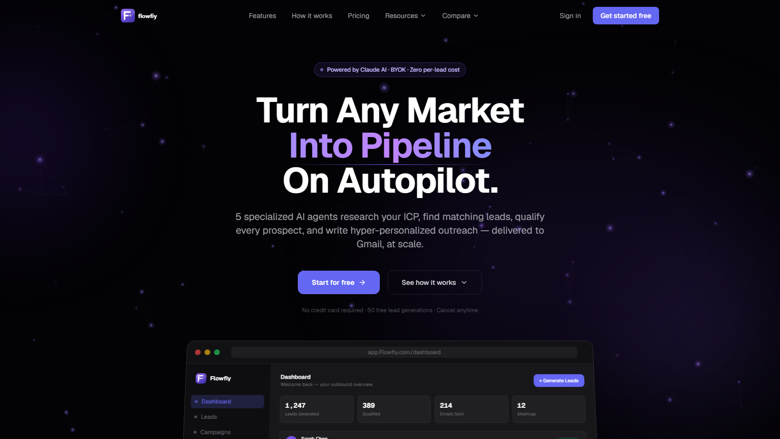
PRE-SEED 2026
The AI Outbound Platform That Doesn't Tax Your API
5 AI agents. Full pipeline. Under 2 minutes per lead.
Ayush Saha, Founder & CEO
Pune, India | flowfiy.com
5
<2m
BYOK
AI agents
per lead
$0 AI cost
01

Slide 2
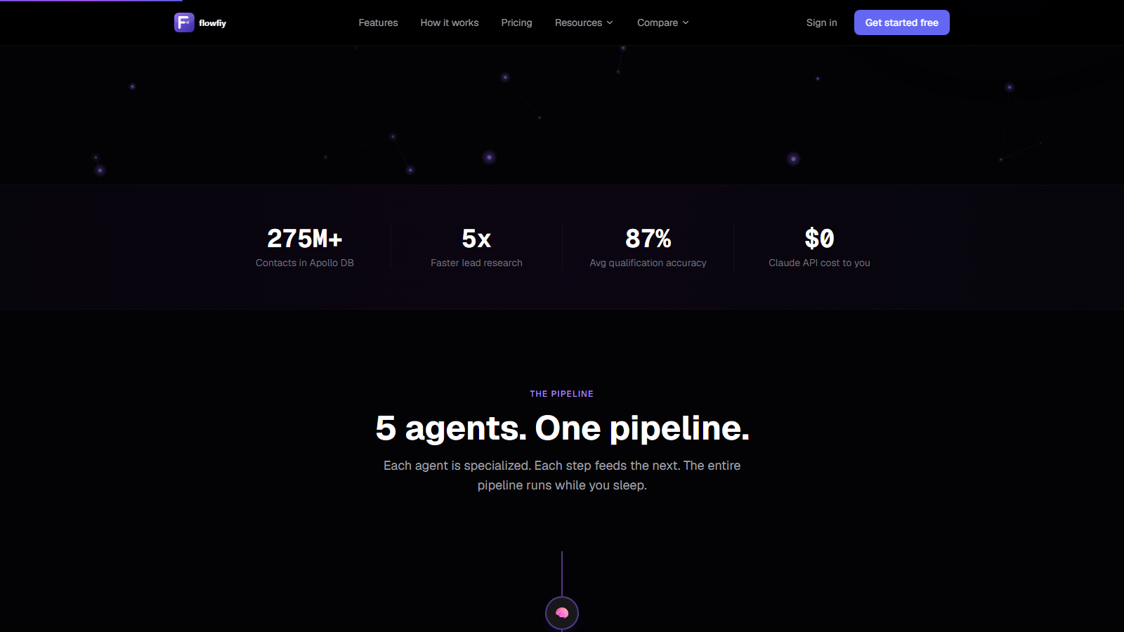
PROBLEM
Outbound is broken - and expensive.
Teams are stacking expensive tools around a manual workflow that still produces generic outreach.
4+ hrs
$60K-$90K
Manual research, qualification and writing per lead
Average annual SDR cost for 1-2 qualified leads/day
88%
$1.4K-$2.1K/mo
Outbound emails go unopened when personalization is thin
Clay + Instantly + ZoomInfo minimum tool stack
Tool-stack trap
Clay enriches, Instantly sends, ZoomInfo feeds, Apollo charges exports. None compounds full lead context into one pipeline.
Founder-provided SDR/tool cost assumptions; unopened-rate cited as outbound benchmark in source deck.
02

Slide 3
SOLUTION
One platform. Five AI agents. Zero SDR overhead.
Users bring their own Anthropic API key. Flowfiy pays $0 in AI costs while each agent passes richer context to the next.
01
02
03
04
05
ICP Analyzer
Lead Discovery
Company Analyzer
Qualification
Personalization
Maps ICP into a targeting signal
Searches 275M+ Apollo contacts
Pulls funding, stack, hiring signals
Scores fit from 0-100
Writes subject, email and follow-ups
<2 min
~95%
$0
Gmail
per lead
gross margin
Claude API cost
OAuth delivery
03

Slide 4
EXAMPLE
From ICP to inbox in under 2 minutes.
User input: "B2B SaaS · Fintech · 50-200 employees · hiring AE or SDR"
1
ICP defined
B2B SaaS fintech, 50-200 emp, AE/SDR hiring signal
2
50 companies
Decision-maker contacts returned with Apollo/Apify filters
3
Research pulled
Funding, tech stack and growth signals per company
4
Leads ranked
Stripe 94/100 · Razorpay 89/100 · Setu 81/100
Result
50 hyper-personalised, ready-to-send emails - one run, one platform.
5
Emails written
Subject line, body and 2 follow-ups per lead
04

Slide 5
MARKET
A $58B market growing at 29.5% annually.
Flowfiy sits at the intersection of AI sales automation, outbound infrastructure and APAC SaaS growth.
AI SDR
$4.12B
$15.01B
TAM
SAM
SOM
$58B
$4.12B
$41.2M
AI in Sales
$24.64B
$145.12B
APAC AI SDR
$1.09B
AI for Sales & Marketing by 2030
AI SDR & outbound automation in 2025
1% SAM capture at ~$99/mo in 3 years
27.42% CAGR
Proof of scale: Clay raised $100M at $3.1B valuation; Apollo reports 500,000+ customers.
Sources: MarketsandMarkets AI SDR Market, Grand View Research AI in Sales, TechCrunch Clay Series C, McKinsey State of AI 2025
05

Slide 6
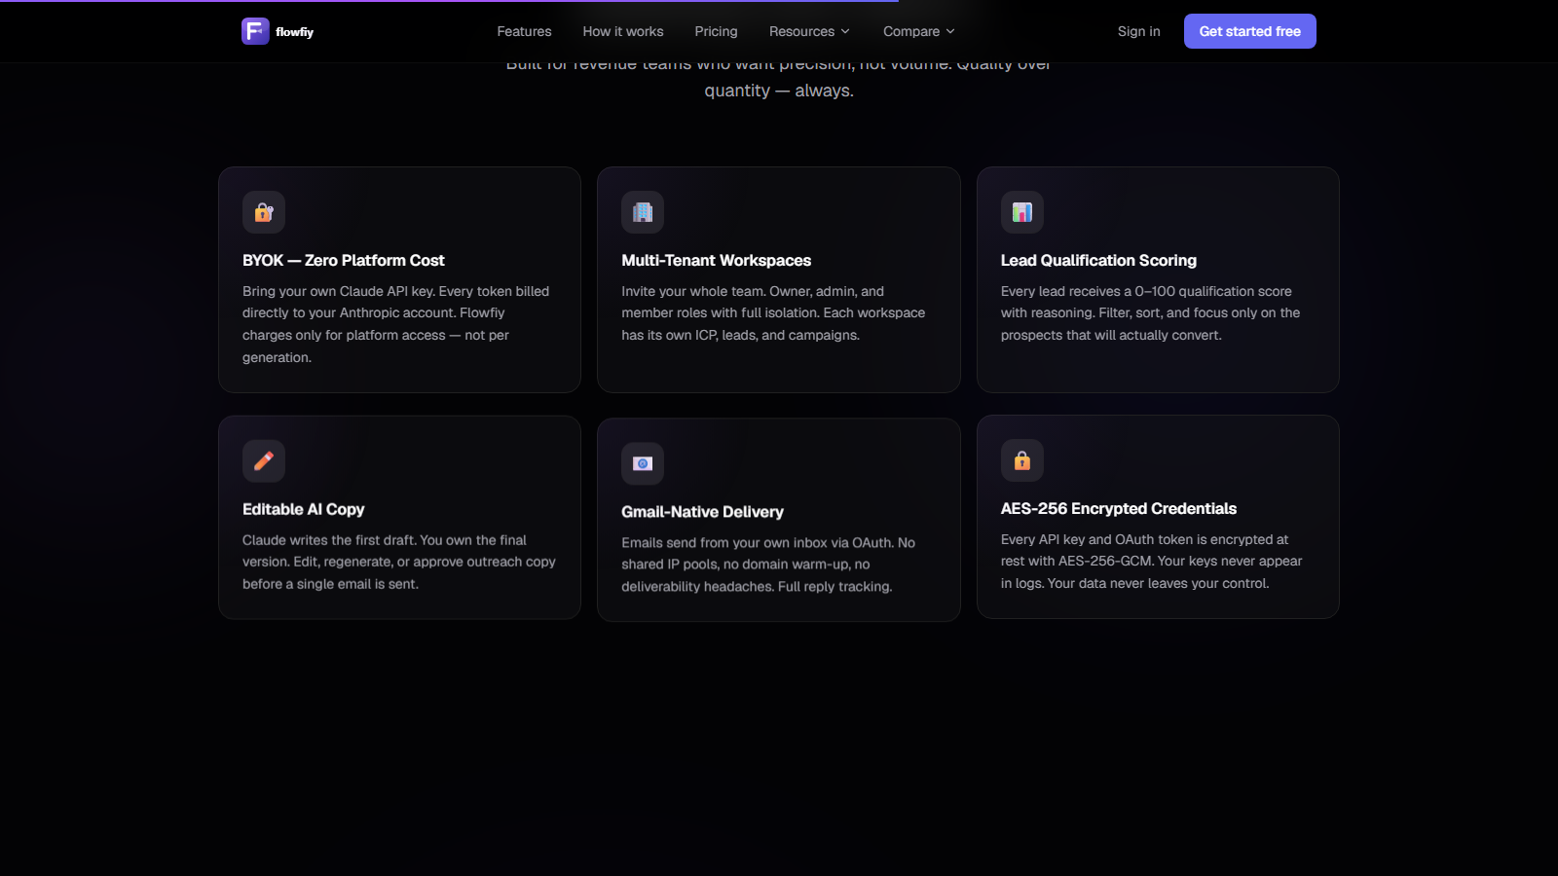
BUSINESS MODEL
Seat + generation pricing. No credits. No API tax.
SaaS pricing with BYOK keeps Claude cost exposure at zero while customers get predictable usage.
Tier
Price
Generations
Seats
Who
Free
$0/mo
50 lifetime generations
1 seat
Acquisition funnel
Starter
$49/mo
500 gen/month
1 seat
Freelancers & founders
Growth
$99/mo
2,000 gen/month
5 seats
Early-stage teams
Agency
$249/mo
Unlimited gen
20 seats
Agencies & scale-ups
~95%+
$0.002
15
Gross margin
Infra cost/gen
Starter subs break-even
Infra stack: Railway + Vercel + Supabase
Competitor pricing cited from founder-provided market scan; margins assume BYOK Claude model and stated infra cost.
06

Slide 7
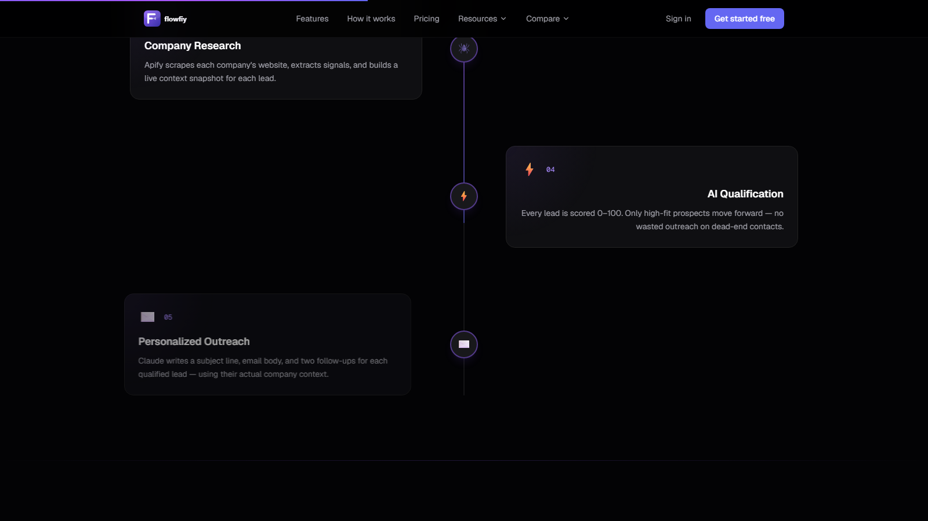
MOAT
Two unfair advantages no competitor can copy today.
BYOK Model
Full-Stack Pipeline
Zero API Cost
Zero Tool Stacking
Users connect their own Anthropic key
Clay enriches only; it cannot send emails
Flowfiy pays $0 in Claude costs
Outreach needs ZoomInfo + enrichment to work
~95% gross margin vs 60-70% category norm
Instantly blasts email without ICP research
Compounding intelligence
No surprise bills or platform-tied usage caps
Flowfiy runs ICP -> discovery -> research -> scoring -> copy -> Gmail
Each agent hands full context to the next, producing a better lead, score and message than stitched tools can.
07

Slide 8
TRACTION
Built. Tested. Ready to launch.
The product is not a concept deck: the pipeline, billing, delivery and multi-tenant foundation are already live.
5-agent pipeline production-ready
Next.js + Supabase + BullMQ + Railway/Vercel stack
BYOK architecture validated with zero Claude cost exposure
Stripe billing + webhook-driven generation limits live
Gmail OAuth outreach integration complete
Multi-tenant architecture with per-org isolation
Why now
88% of enterprises use AI in at least one function; Clay's $3.1B Series C validates AI GTM automation; APAC AI SDR is the fastest-growing region.
Sources: McKinsey State of AI 2025; TechCrunch Clay Series C; MarketsandMarkets AI SDR market.
08

Slide 9
FUND UTILISATION
$300,000 · 18-month runway · Series A ready.
Pre-Seed SAFE Note · $3M pre-money valuation · 10% equity
Milestones at month 11
500+
paying customers
Product & Engineering
40% -> $120,000
Feature dev, mobile app, integrations, new agents
$49K+
Sales & Marketing / GTM
30% -> $90,000
Paid acquisition, SEO, Product Hunt, partnerships
MRR at avg $99/customer
Infrastructure & DevOps
15% -> $45,000
Scale-up, monitoring, security audits, SLAs
Series A
Team & Talent
10% -> $30,000
1 full-stack engineer, part-time growth marketer
fundraise initiated
Legal & Compliance
5% -> $15,000
Incorporation, SAFE docs, IP, GDPR/DPDP
Founder-provided financing terms and use-of-funds plan.
09

Slide 10
CLOSING
Let's build the future of outbound together.
Become the outbound infrastructure layer for every AI-native sales team globally.
Raising
Instrument
$300,000
SAFE Note
Pre-money
Equity
$3,000,000
10%
Ayush Saha
Book a 15-min demo: flowfiy.com
Founder & CEO, Flowfiy · Pune, India
hello@flowfiy.com
Market moment
The $4.12B AI SDR market is growing at 29.5% annually - Flowfiy enters as teams search for cheaper, more complete automation.
Sources: MarketsandMarkets AI SDR Market; founder-provided financing terms.
10

